Slide 1
Introductory Programming Techniques
North Metropolitan TAFE – Joondalup
Semester 1 - 2023
Courses:
Certificate III in Information Technology Certificate IV in IT (Programming) Certificate IV in IT (Networking) Certificate IV in IT (Cybersecurity) Certificate IV in IT (Web)

Slide 2
String Data Type
A string is a sequence of characters
A string literal uses quotes 'Hello' or "Hello"
For strings, + means “concatenate”
When a string contains numbers, it is still a string
We can convert numbers in a string into a number using int()

Slide 3
Reading and Converting
We prefer to read data in using strings and then parse and convert the data as we need
This gives us more control over error situations and/or bad user input
Input numbers must be converted from strings

Slide 4
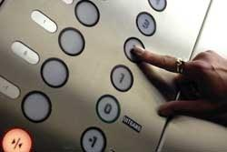
Looking Inside Strings
We can get at any single character in a string using an index specified in square brackets
The index value must be an integer and starts at zero
The index value can be an expression that is computed
b
a
n
a
n
a
0
1
2
3
4
5
>>> fruit = 'banana'
>>> letter = fruit[1]
>>> print(letter)
a
>>> x = 3
>>> letter = fruit[x - 1]
>>> print(letter)
n

Slide 5
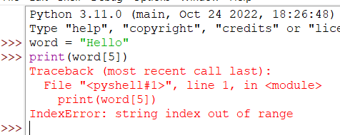
A Character Too Far
You will get a python error if you attempt to index beyond the end of a string
So be careful when constructing index values and slices

Slide 6
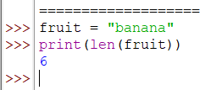
Strings Have Length
The built-in function len gives us the length of a string.
b
a
n
a
n
a
0
1
2
3
4
5

Slide 7
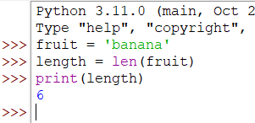
len Function
A function is some stored code that we use. A function takes some input and produces an output.
len()
function
'banana'
(a string)
6
(a number)

Slide 8
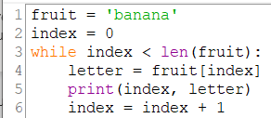
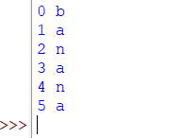
Looping Through Strings
Using a while statement, an iteration variable (index), and the len function, we can construct a loop to look at each of the letters in a string individually
Code | Output

Slide 9


Looping Through Strings
A definite loop using a for statement is much more elegant
The iteration variable is completely taken care of by the for loop
Code | Output

Slide 10
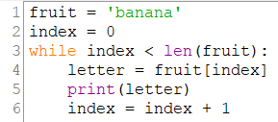
Looping Through Strings comparing the two options
While loop | For loop | Output for both
The for loop is much neater and elegant code.

Slide 11
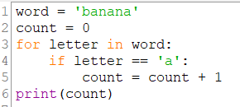

Looping and Counting
This is a simple loop that loops through each letter in a string and counts the number of times the loop encounters the 'a' character
Code | Output

Slide 12
Looking Deeper into in
The iteration variable “iterates” through the sequence (ordered set)
The block (body) of code is executed once for each value in the sequence
The iteration variable moves through all of the values in the sequence
Iteration variable
Six-character string
for letter in 'banana' :
print(letter)

Slide 13
Yes
Done?
No
b
a
n
a
n
a
Advance letter
print(letter)
for letter in 'banana' :
print(letter)
The iteration variable “iterates” through the string and the block (body) of code is executed once for each value in the sequence

Slide 14
More String Operations

Slide 15
Slicing Strings
M
o
n
t
y
P
y
t
h
o
n
0
1
2
3
4
5
6
7
8
9
10
11
We can also look at any continuous section of a string using a colon operator
The second number is one beyond the end of the slice - “up to but not including”
If the second number is beyond the end of the string, it stops at the end
>>> word = 'Monty Python'
>>> print(word[0:4])
Mont
>>> print(word[6:7])
P
>>> print(word[6:20])
Python

Slide 16
Slicing Strings
M
o
n
t
y
P
y
t
h
o
n
0
1
2
3
4
5
6
7
8
9
10
11
If we leave off the first number or the last number of the slice, it is assumed to be the beginning or end of the string respectively
>>> word = 'Monty Python'
>>> print(word[:2])
Mo
>>> print(word[8:])
thon
>>> print(word[:])
Monty Python

Slide 17
String Concatenation
>>> word = 'Hello'
>>> greeting = word + 'There'
>>> print(greeting)
HelloThere
>>> greeting = word + ' ' + 'There'
>>> print(greeting)
Hello There
>>>
When the + operator is applied to strings, it means “concatenation”

Slide 18
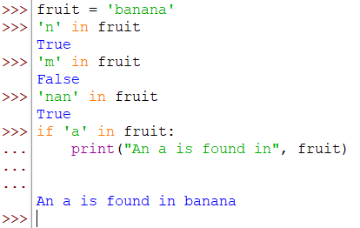
Using in as a Logical Operator
The in keyword can also be used to check to see if one string is “in” another string
The in expression is a logical expression that returns True or False and can be used in an if statement

Slide 19
String Comparison
if word == 'banana':
print('All right, bananas.')
if word < 'banana':
print('Your word,' + word + ', comes before banana.')
elif word > 'banana':
print('Your word,' + word + ', comes after banana.')
else:
print('All right, bananas.')

Slide 20
String Library
Python has a number of string functions which are in the string library
These functions are already built into every string - we invoke them by appending the function to the string variable
These functions do not modify the original string, instead they return a new string that has been altered
>>> greet = 'Hello Bob'
>>> zap = greet.lower()
>>> print(zap)
hello bob
>>> print(greet)
Hello Bob
>>> print('Hi There'.lower())
hi there
>>>

Slide 21
>>> stuff = 'Hello world'
>>> type(stuff)
<class 'str'>
>>> dir(stuff)
['capitalize', 'casefold', 'center', 'count', 'encode', 'endswith', 'expandtabs', 'find', 'format', 'format_map', 'index', 'isalnum', 'isalpha', 'isdecimal', 'isdigit', 'isidentifier', 'islower', 'isnumeric', 'isprintable', 'isspace', 'istitle', 'isupper', 'join', 'ljust', 'lower', 'lstrip', 'maketrans', 'partition', 'replace', 'rfind', 'rindex', 'rjust', 'rpartition', 'rsplit', 'rstrip', 'split', 'splitlines', 'startswith', 'strip', 'swapcase', 'title', 'translate', 'upper', 'zfill']
https://docs.python.org/3/library/stdtypes.html#string-methods

Slide 22
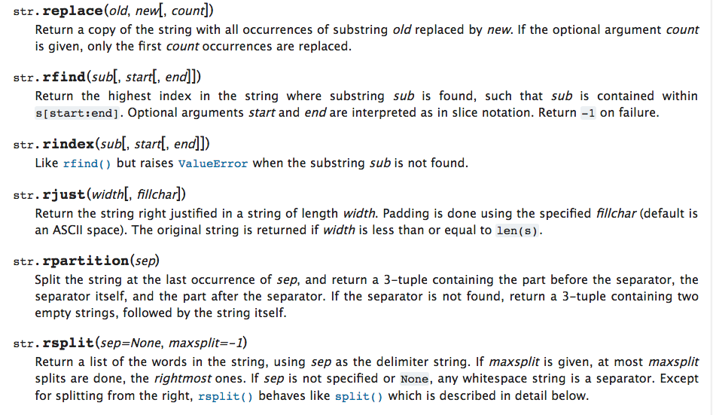

Slide 23
String Library
str.capitalize()
str.center(width[, fillchar])
str.endswith(suffix[, start[, end]])
str.find(sub[, start[, end]])
str.lstrip([chars])
str.replace(old, new[, count])
str.lower()
str.rstrip([chars])
str.strip([chars])
str.upper()

Slide 24
Searching a String
b
a
n
a
n
a
0
1
2
3
4
5
We use the find() function to search for a substring within another string
find() finds the first occurrence of the substring
If the substring is not found, find() returns -1
Remember: string position starts at zero
>>> fruit = 'banana’
>>> position = fruit.find('na’)
>>> print(position)
2
>>> print(fruit.find('z’))
-1

Slide 25
Making everything UPPER CASE
You can make a copy of a string in lower case or upper case
Often when we are searching for a string using find() we first convert the string to lower case so we can search a string regardless of case
>>> greet = 'Hello Bob’
>>> greet_upper = greet.upper()
>>> print(greet_upper)
HELLO BOB
>>> greet_lower = greet.lower()
>>> print(greet_lower)
hello bob
>>> print(greet)
Hello Bob

Slide 26
Search and Replace
The replace() function is like a “search and replace” operation in a word processor
It replaces all occurrences of the search string with the replacement string
>>> greet = 'Hello Bob'
>>> nstr = greet.replace('Bob','Jane')
>>> print(nstr)
Hello Jane
>>> nstr = greet.replace('o','X')
>>> print(nstr)
HellX BXb
>>>

Slide 27
Stripping Whitespace
Sometimes we want to take a string and remove whitespace at the beginning and/or end
lstrip() and rstrip() remove whitespace at the left or right
strip() removes both beginning and ending whitespace
>>> greet = ' Hello Bob '
>>> greet.lstrip()
'Hello Bob '
>>> greet.rstrip()
' Hello Bob'
>>> greet.strip()
'Hello Bob'
>>>

Slide 28
Prefixes
>>> line = 'Please have a nice day'
>>> line.startswith('Please')
True
>>> line.startswith('p')
False

Slide 29

Parsing and Extracting
21
31
From stephen.marquard@uct.ac.za Sat Jan 5 09:14:16 2008
>>> data = 'From stephen.marquard@uct.ac.za Sat Jan 5 09:14:16 2008'
>>> atpos = data.find('@')
>>> print(atpos)
21
>>> sppos = data.find(' ',atpos)
>>> print(sppos)
31
>>> host = data[atpos+1 : sppos]
>>> print(host)
uct.ac.za

Slide 30
Two Kinds of Strings
Python 2.7.10
>>> x = '이광춘'
>>> type(x)
<type 'str'>
>>> x = u'이광춘'
>>> type(x)
<type 'unicode'>
>>>
Python 3.5.1
>>> x = '이광춘'
>>> type(x)
<class 'str'>
>>> x = u'이광춘'
>>> type(x)
<class 'str'>
>>>
In Python 3, all strings are Unicode

Slide 31
Caesar cipher
Change your Caesar cipher to accept a string as input, no longer a shift and a word.
The string will consist of the following information:
Character 1: will be d (decrypt) or e (encrypt), should work for lower- and upper-case characters.
Character 2 - 4: The number of characters used for encryption. No tests needs to be done to ensure the user does not “encrypt with” 26.
Encryption can be negative.
Character 5+: Message that needs to be encrypted.
All characters need to be encrypted or decrypted.

Slide 32
Caesar cipher explanation
Input | Comment | Output
e 3 hello | e – encrypt “ 3 ” – shift is 3. | khoor
e 3hello | e – encrypt “ 3” – shift is 3. | khoor
d 3 khoor | d – decrypt Character 3-5: always shift used in encryption decryption shift is in this example -3 Encryption number * -1 | hello
E -5Best Wishes | e – encrypt Encrypt with -5 | =`no Rdnc`n
D-5 =`no Rdnc`n | d – decrypt | Best Wishes

Slide 33
Caesar cipher examples
Examples of output
Welcome to Caesar cipher program What is your name? Ingrid Ingrid hope you enjoy encrypting and decrypting words. ############################### Enter a string containing the following: First character e for encrypt, d for decrypt Next three characters: number of characters to encrypt with or number of characters message was encrypted with originally number may be a negative number ############################### >>> e-3 hello world ############################### The encrypted word is: ebiil tloia | Welcome to Caesar cipher program What is your name? Ingrid Ingrid hope you enjoy encrypting and decrypting words. ############################### Enter a string containing the following: First character e for encrypt, d for decrypt Next three characters: number of characters to encrypt with or number of characters message was encrypted with originally number may be a negative number ############################### >>> d -3ebiil tloia ############################### The decrypted word is: hello world

Slide 34
Possible solution
def encrypt(shift, word): '''encrypt the message''' message = "" for letter in word: message = message + chr(ord(letter)+shift) return(message) def user_input(): print("\n###############################") print("Enter a string containing the following:") print("First character e for encrypt, d for decrypt") print("Next three characters:") print("number of characters to encrypt with or") print("number of characters message was encrypted with originally") print("number may be a negative number") print("\n###############################") encrypt_decrypt_string = input(">>> ") print(f"\n###############################") return (encrypt_decrypt_string)
#main program starts here DECRYPT_SWITCH = -1 username = welcome() encrypt_decrypt_string = user_input()
try: pre_fix = encrypt_decrypt_string[:4].lower() shift = int(pre_fix[1:].strip()) if pre_fix[0].lower() == "e": print('The encrypted word is:', encrypt(shift, encrypt_decrypt_string[4:])) elif pre_fix[0].lower() == "d": print('The decrypted word is:', encrypt(shift*DECRYPT_SWITCH, encrypt_decrypt_string[4:])) else: print("Could not perform the encryption / decryption due to invalid input.") except: print("Shift is not a number, cannot encrypt / decrypt the message.")

Slide 35
Summary
String type
Read/Convert
Indexing strings []
Slicing strings [2:4]
Looping through strings with for and while
Concatenating strings with +
String operations
String library
String comparisons
Searching in strings
Replacing text
Stripping white space

Slide 36
Beyond Strings
How can the dir() function help us discover new capabilities in Python
How can you use dir and the help function together
What does the dot notation (accessor) do?

